Slide 1

Show & Tell
Customer Research
Wednesday, 1st August 2018

Slide 2
Research Team
Who We Are
Tress Carmichael
Lorna Hayton
Martin Kerr
Anubhav Mittal
Linda Sutherland
What We Do
Variety of research activities and data analysis with the aim of getting feedback and insights directly from businesses we work with now and those that might work with us in future
Work in an agile multi-disciplinary team environment, focused on service design and support for SE’s digital transformation of its services
We work within a wider team of designers, analysts, developers
We conduct User Research and generate findings to shape the development of new digital services from discovery work to live
Focus on user needs is maintained

Slide 3
Our Approach
We use a variety of research methodologies to reveal actionable insights enabling a rich picture of customers and other user groups
Understand the business problem and devise appropriate research strategies
Plan and design customer research sessions, testing both high level concepts and specific aspects of the service as it is designed and developed
Lead usability testing process from developing user recruitment briefs through to test moderations, analysis and report writing
Conduct research F2F, telephone, online, including guerrilla/pop-up testing
Work closely with web analytics to integrate customer data and research findings
Develop and present business/design recommendations based on analysis of findings within the user research projects

Slide 4
Online Channels SE.com & SDI.co.uk
Purpose
To understand what customers want from the online domestic & international channels
To test the strategic design principles
To perform usability testing on the website wireframe prototypes, to validate initial concepts for future state layout/design.
To inform the next design iteration
Customer Profiles:
Scottish companies, non retail, turnover > 500K and not currently receiving support from us
Field Staff, International companies with potential to invest, Globalscots
Sample
184 customers and staff engaged with us on the project
F2F - 68
Online - 105
Telephone - 11

Slide 5
SE.com Discovery
We explored:
Information looked for from Business Support organisations
Where they currently go for such support
Use of Online Channels
Organisations providing good support & what does that look like
Likely transactions on SE.com

Slide 6
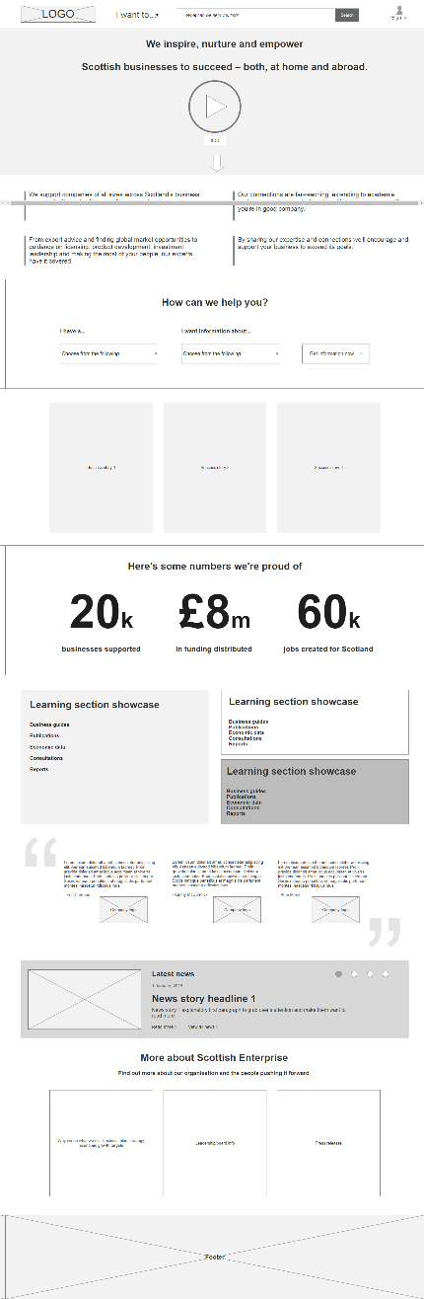
Prototypes: Home page
☺
☹
Everyone clicked on the video
“I Want To” menu was almost totally ignored
These statements got in the way of the next section
Most people gravitated towards this
Well received
The STAT’s were very well received, although authenticity was questioned
Not well understood or received
Well received
Mild praise but not warmly received
Most users viewed this as overkill on a home page

Slide 7
SE.COM Screenshots
We then asked users to view the prototype sketches of specific journeys:
Guides Sections - needs to be higher up
Eligibility for services made clear upfront, or signposting to other organisations who could help
I want the homepage to be tailored to me
Video – don’t want SE promotional video. Needs to be changed very regularly to show the website is keeping up to date, “videos of case studies more impact”.
Sign in – business account with multiple logins preferred
Language unclear and off putting, too much jargon
The website needs to link to all other agencies offering businesses support and funding – what can we do? Who else can fill the gaps? A portal to all types of support
Innovation important – could be upfront on site
The categories for support look right
Stats – impressive but not relevant to me
Case studies – would prefer how to help companies achieve growth within the success stories. They need to be relevant to business age, stage of journey and industry
Interactive – how can I feedback about the guides/drop downs if my industry isn’t listed? I want to add my knowledge.
“leadership and learning is clumsy”
“SPOT ON!”

Slide 8
Themes
General
Customers confused where to go for the right information
Customers often unsure of which organisation they are dealing with
Customers unclear why they get grant/support rejected
Requesting Customer Details
Don’t ask for too much information too early in the journey (eg high degree of surprise in asking for Companies House information)
Belief that inputting details would result in “being marketed to”
Communication
Majority of users preferred telephone number to call if they got stuck
Live Chat mixed reviews
Businesses are interested in help from organisations (such as SE) BUT only if it is relevant to them
Information
Language needs to be clear
The journey to get to relevant information should be simple and quick
Large and impressive Stats are popular (but users questioned if they were real)
Information ”Below the Fold” remains a very real barrier to some users seeing the actual CTA’s
Content
Users expect most things to be clickable
Users expect interaction to be quick so indicated time it takes seen as irrelevant
The “Search Bar” was used as the preferred bailout method, when the user struggled to find what they were looking for
Menu Options were well received (though sometimes missed initially)
Too much content not well received (eg Learning/Development section showcase because not relevant to them at this time)
Case Studies are good but need to be directed to me and my sector

Slide 9
Discovery - SDI.co.uk
Purpose
To gain insight from field teams on what customers need from the SDI website and thoughts on the content.
To gain insight from GlobalScots on drivers for relocating and investing in different locations.
To inform the next iteration of the website
Sample
Number: 9 staff / 5 Globalscots
Country: India, US, London, Germany, Glasgow
Type: Skype and Face to Face testing

Slide 10
Key Themes
Field Staff
Company priorities are Finance, Staff and Opportunities
Language needs to be more positive and sales orientated
Headline is unpopular as it mentions London and positions Scotland as 2nd best
Brexit content is important
Enthusiasm for the Guide to Scotland
Globalscots
Talent and skills – number one critical factor
Stability – key to attract investment
Brexit – Needs to be addressed, sector specific concerns
Critical factors in foreign direct investment – Talent and skills, education, grants, tax, funding, sustainability
Scotland’s attractiveness – Skills, universities, innovation and ease of set-up
“Needs to be more sales orientated rather than facts/guides”
“So what makes Scotland different?”
“Non-native English speakers might not use these words”
“Show me market opportunities”
“Have an ‘Oven Ready’ catalogue of investment opportunities”
“What is the UK post Brexit?
Is it even the UK?”
“Investors are quite impressed with SE and Visit Scotland support. It is much tougher to get that level of support in London”

Slide 11
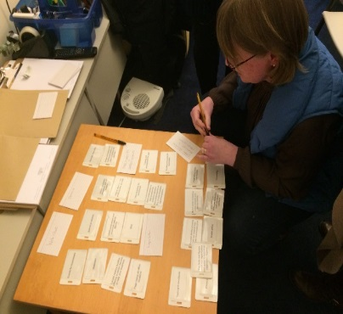
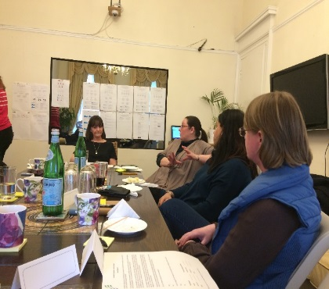
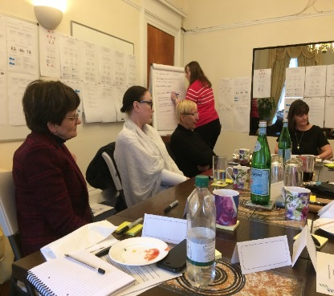
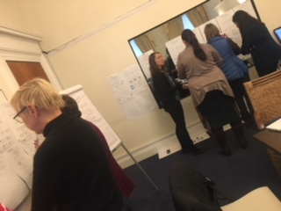
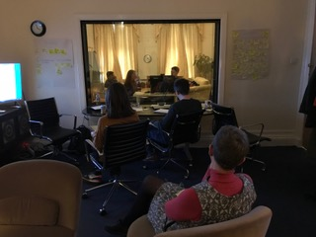
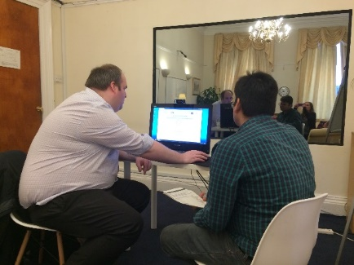
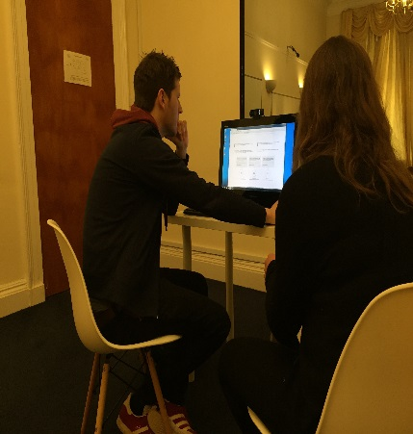
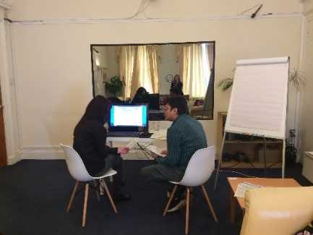
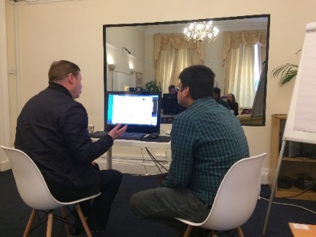
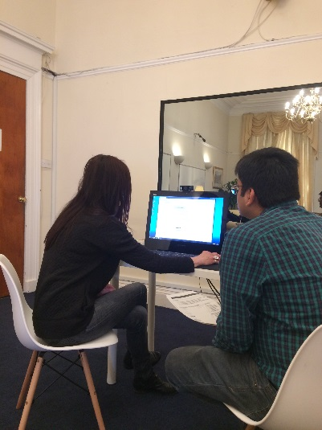
Quotes
“The Stats look Great – are they real?”
I don’t want an account at this stage. I am only making an enquiry”
“FAQ’s were cool” in the live chat box.
““I love things on the internet that are simple such as HMRC”
“I would apply online as long as the form is not 10 pages long”
“I just wouldn’t scroll”
““I am not in that category anymore so I am not sure how you can help me”

Slide 12
Next Steps
Upcoming Research:
Ongoing SE.com
Ongoing SDI.co.uk
Corporate Website
Brexit Diagnostic
Funding & Support (Large Grants Single Approval Paper & Offer Letter)

